Slide 1
GNU/Linux System Support
CST8207
Week-2, L-2
Sep 15, 2025
By: Gurpreet Singh Sidhu

Slide 2
Topics
Globbing (Shell GLOB Patterns)
I/O Redirection
Pipe Lining
Command

Slide 3
To Remember
In Unix/Unix Like OS, All directories are located below the root (/)
All directories are separated by the use of a slash character (/)
All commands, file and directory’s names are case sensitive
File/Directory Path:
1) Absolute Path (Start with “ / “ always)
2) Relative Path (not starts with “ / “ )
3) .. means one level up in directory tree
4) . Refers to current directory

Slide 4
Some Definitions
GLOB patterns (wildcard patterns)Characters that the shell will try to expand to match existing pathnames in the file system. These characters are sometimes called “wildcard” characters in other systems.
$ cp a* .. # The character * is a GLOB pattern
metacharacter (meta-character)
A character that has a special meaning to the shell. The letter a or the digit 1 have no special meaning to the shell and they are not shell metacharacters. GLOB pattern characters like ’*’ (asterisk/star) are metacharacters, and also semicolons, blanks/spaces, and many other symbols.
$ clear ; sort file.txt >sorted_file.txt # The blank (space), ';' and '>' are metacharacters
You can usually turn a metacharacter into an ordinary non-special character by quoting it. (See below for “quoting”.)

Slide 5
Some Definitions
quoting
Turning off the special meaning of metacharacters by surrounding them with single or double quotes, or putting a backslash in front of them:
$ echo 'This is a semicolon; the single quotes hide it from the shell.'
$ echo "This is a semicolon; the double quotes hide it from the shell."
$ echo This is a semicolon\; the backslash hides it from the shell.
hidden names
Names that start with a leading period (dot – .) are not shown by default by some commands (e.g. ls) and pathnames with leading periods are never matched by GLOB metacharacters, even GLOB lists that contain a period such as [.]. Names starting with periods are called “hidden” names,
e.g. hidden files and hidden directories.

Slide 6
Globbing (Shell GLOB Patterns)

Slide 7
Globbing (Shell GLOB Patterns)
Your shell has a pathname-matching (wildcard) feature that makes operating on large numbers of pathnames easy:
The Unix name for wildcard pattern matching is GLOBbing, from the idea that the pattern matches a “global” list of names. Other operating systems may call these wildcard characters.
GLOB patterns cannot generate any names that do not exist. The GLOB patterns must always match existing names.
Example:

Slide 8
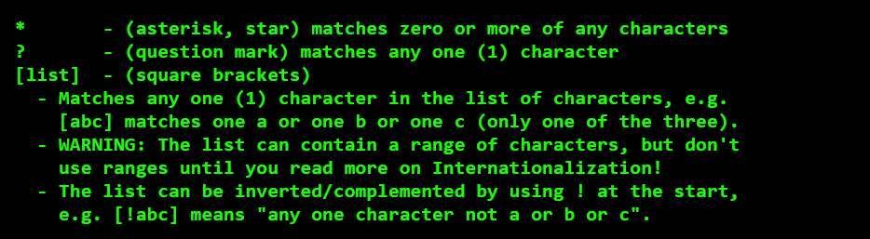
Globbing (Shell GLOB Patterns)
NOTE:-
GLOB metacharacters never match the leading period on any hidden names, so you don’t have to worry about matching the names . or .. accidentally.

Slide 9
Using * to match any number of any characters
As a GLOB metacharacter, the asterisk * matches zero or more of any character in a name, including spaces or other strange characters. The * never matches the leading period on a hidden name, so echo * never shows any names starting with a period.
The GLOB pattern *foo matches non-hidden names ending with foo, including foo, xxxfoo and 123foo.
The GLOB pattern foo* matches names beginning with foo, including foo, fooxxx and foo123.
The GLOB pattern *foo* matches non-hidden names containing foo anywhere, including foo, fooxxx and 123foo and ZZZfoo@@@.

Slide 10

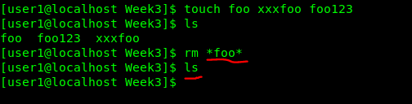
Example

Slide 11
Using ? to match only one single character, any character
As a GLOB metacharacter, the question mark ? matches exactly one of any character in a name, including a space or other strange character. The ? never matches the leading period on a hidden name, so echo ? never shows the current directory name . that is a single period.
The GLOB pattern ??? matches non-hidden names that are exactly three characters long.
The GLOB pattern ???* matches non-hidden names that are three or more characters long.

Slide 12
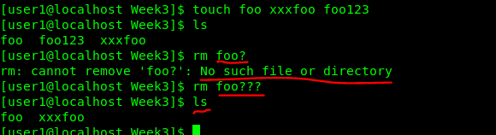
Example

Slide 13

Using [] to match single characters from a list
As a GLOB metacharacter pair, the square brackets [] match exactly one character in a name from a list of characters. The list of characters can never match the leading period on a hidden name, so echo [.] never shows the current directory name . that is a single period.
The GLOB pattern [abc] does not match the three-character name abc; it matches only the one-character names a or b or c:

Slide 14
Using [] to match single characters from a list
No matter how many characters are in the list, a [list] pattern will only match exactly one of the characters in the list, not more than one, not less.
The GLOB patterns [aA] and [a][A] are very different:
The GLOB pattern [aA] is one list, so it matches only one-character names. It matches any one character from the list [aA], so it matches any one-character name that is either a or A.
The odd GLOB pattern [a][A] is made up of two lists, so it matches only two-character names. It matches only the two-character name aA that is made up of a (taken from the first list) followed by A (taken from the second list). It only matches aA.

Slide 15

Example

Slide 16


Example

Slide 17

Using [] to match single characters from a list

Slide 18
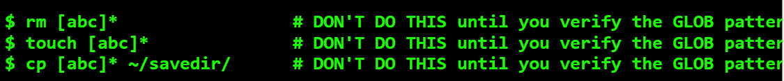
Verifying GLOB patterns before using them
Until you are sure you know how the shell uses GLOB patterns to match names, use the echo or ls command to see what names are being matched (if any). Before you do any of these commands using a GLOB pattern:
Try one of these harmless display commands to verify that the GLOB pattern matches the correct names:
(The –d option makes ls show only the names of any directories, not their contents as it usually does.)

Slide 19
GLOBbing is always done by the shell
Unlike DOS/Windows wildcarding, the GLOB features are done by the shell, not by the individual programs called by the shell.
The shell will do this GLOB expansion irrespective of the name of the command being used, even if the command being used does not accept or process pathnames. The shell does not know which commands expect pathnames; the shell always expands tokens that have GLOB patterns in them, no matter what the command is.
Example:

Slide 20

Quoting to hide GLOB metacharacters
If you do not want GLOB processing to happen, hide the GLOB characters from the shell by using quoting – surround the token with single or double quotes or precede each GLOB metacharacter with a backslash:
NOTE:- GLOB metacharacters never match leading periods (hidden names)

Slide 21
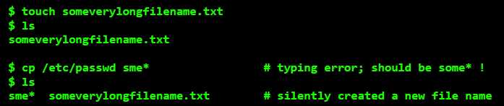
Unmatched GLOB patterns are passed unchanged
In Bourne-style shells (e.g. BASH on Linux), if the shell cannot match a GLOBpattern on the command line against any existing pathname, the GLOB pattern is silently left unchanged by the shell and passed unchanged to the command being used.
No error message is generated by the shell by the failed GLOB; the command runs with the unchanged argument still containing the unmatched GLOB metacharacters. This is almost never what you want. For example:

Slide 22
I/O Redirection

Slide 23
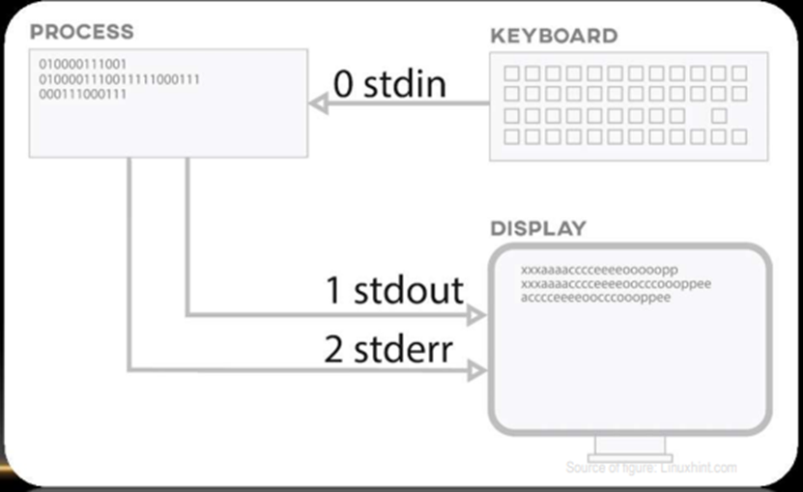
I/O Redirection
Shell redirection is a powerful way to change from where commands read input and to where commands send output.
It applies to every command run by the shell, so once you learn the shell syntax of how it works, it works on all the commands you can type into the shell.

Slide 24
I/O REDIRECTION
Input and output in the Linux environment is distributed across three streams
Standard Input (stdin) symbol “<“ e.g: $ cat < file1.txt
Standard Output (stdout) symbol “>” e.g: $ ls /etc/passwd > file1.txt
Standard Error (stderr) symbol “2>” e.g: $ mkdir dir1 di2 2> error.log
• The standard input (stdin) device is reading from the keyboard but you could redirect it to read from a file
• The standard output (stdout) device is the screen but your could redirect it to send output to a file
• The standard error, by default, error stream is displayed on Terminal. Error redirection is routing the errors to a file other than the screen.
• ">" is the output redirection operator. ">>" appends output to an existing file
• Tip: 2>&1 send all error message where the standard output go

Slide 25
Redirection of input – redirection of output
You can redirect the input of a command away from your keyboard, and you can redirect the output of a command away from your screen.
The redirection can be to or from a file using the shell meta-characters ‘>’ or ‘<’ (angle brackets) or it can be to or from a program using the shell meta character ‘|’ (the pipe symbol).

Slide 26
Output Redirection Normal Output: Standard Output – stdout
Commands produce two kinds of output – normal output and error message output – and the shell can redirect each of these separately.
In the process of output redirection, the shell (not the command) redirects (diverts) most command output that would normally appear on the screen to some other place. The redirection can be either into a file using a file output redirect meta-character ‘>’, or into the input of another command by separating the commands using a pipe meta-character ‘|’:
NOTE:-
The normal command output that appears on your screen is called the standard output of the command, abbreviated stdout.
Anything written to stdout can be redirected as shown in the above examples.

Slide 27
Error Messages: Standard Error – stderr
If something goes wrong, commands produce error messages. These error message are sent to what is called the standard error output of the command, abbreviated stderr. Error messages are almost always sent to your screen, even if you redirect stdout somewhere else:
Standard error output is not subject to simple output redirection, but with extra syntax the shell can redirect it, too, into a file:

Slide 28
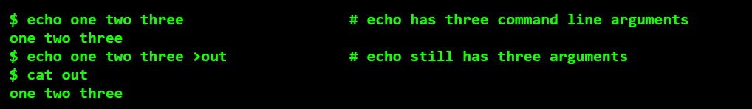
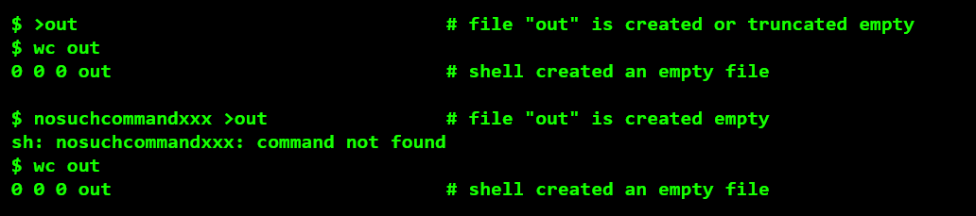
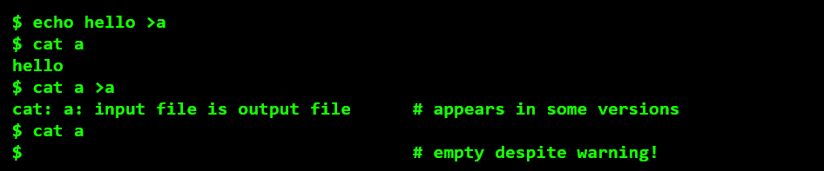
Four Rules for Output Redirection
1. Redirection is done for the command by the shell, first, before finding and running the command; the shell has no idea if the command exists or will produce any output. The shell performs the redirection before it finds or runs the command.
Example-

Slide 29
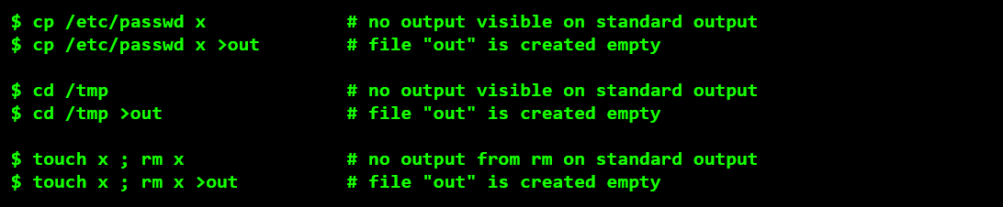
2. The shell can only redirect output that is produced by the command. You can only redirect the output that you can see. If there is no visible output on your screen without redirection, adding redirection won’t create any. Re-read this a few times and remember it.
Example -

Slide 30
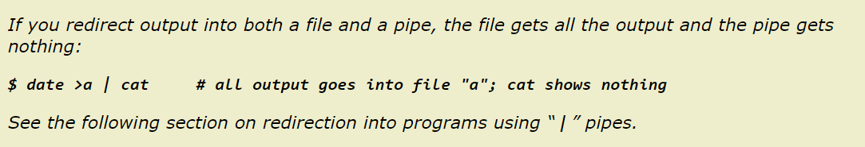
3. Redirection can only go to one place. You can’t use multiple redirections to send output to multiple places.

Slide 31
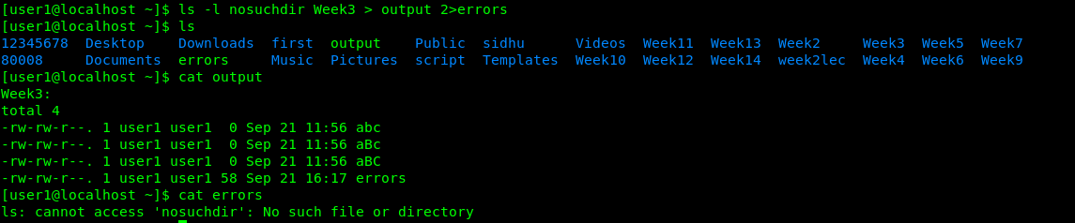
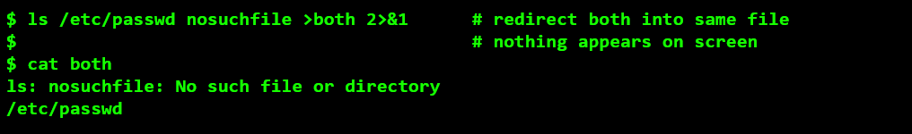
4. By default, error messages (called “standard error” or stderr) are not redirected; only “normal output” (called “standard output” or stdout) is redirected. (You can also redirect stderr with more shell syntax; see below.)
Standard Output (stdout) is unit 1 – redirect it using >outfile or 1>outfile
Standard Error Output (stderr) is unit 2 – redirect it using 2>outfile
Both is same file 2>&1

Slide 32

Output file redirection syntax can go anywhere
In every case above the echo command sees exactly three command line arguments and all three arguments “hi”, “there”, and “mom” are all redirected into the output “file”.
The file redirection is found and done first by the shell, then the redirection syntax is removed from the command line before the command is called. The command actually being run doesn’t see any part of the redirection syntax; the number of arguments is not affected.

Slide 33
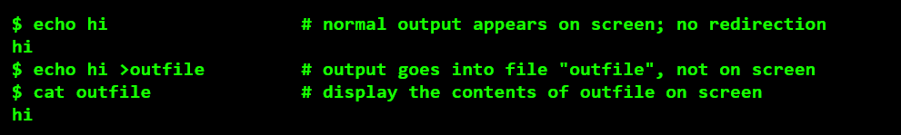
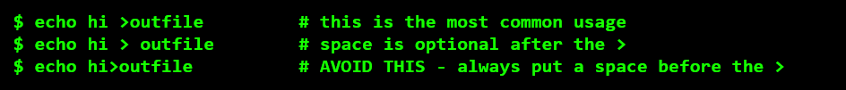

Examples

Slide 34

Input Redirection – Standard Input
Many Unix/Linux commands read input from files, if file pathnames are given on the command line. If no file names are given, these commands usually read from what is called Standard Input (“stdin”), which is usually connected to your keyboard. (You can send EOF by typing ^D (Ctrl-D) to get the command to stop reading your keyboard.)
Example:-

Slide 35
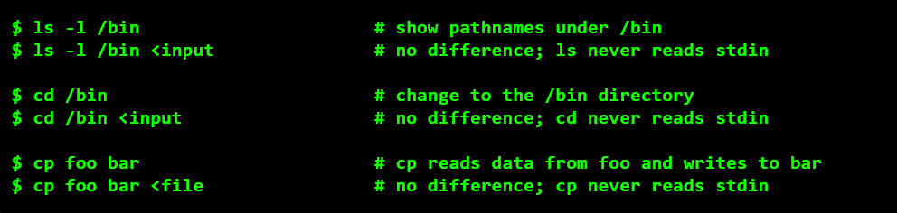
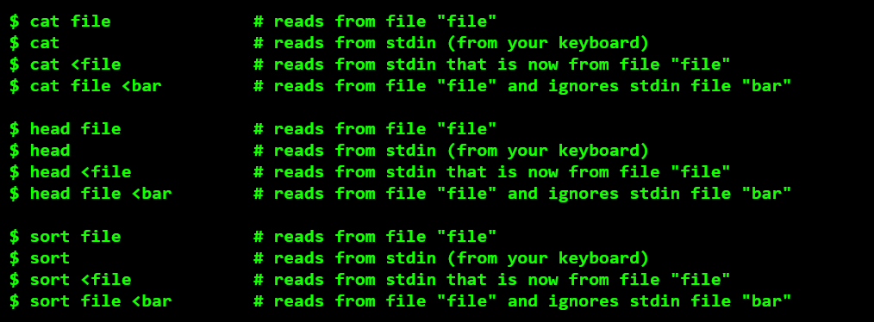
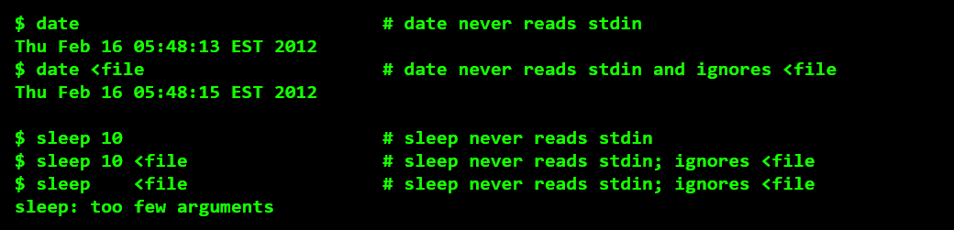
Example

Slide 36
LINUX PIPING

Slide 37

LINUX PIPING
We could send data from one program to another. It's called piping and the operator we use is ( | )
• The output from one program become the input for another program
e.g:
• $ ls / | more # sending output of ls to more command which shows out put page by page
• $ ls / | more #sending output of ls to more command which shows out put page by page
• $ ls /etc | sort | head -5 #send output of ls / to the sort command and show 5 first lines
• $ ls /home/user1 | wc -l # send out of ls command to wc to count how many line the output are

Slide 38
I/O REDIRECTION VS PIPING
What is the difference between Redirections & Pipeling
• Both of them basically do same thing, they redirect a FD (file descriptor) of the process executed. The method are different.
• A pipe takes the output from the stdout of one process and feed into the stdin of other process
• redirection redirects stdout to a file (>) or redirects input from a file to stdin (<)

Slide 39
find
The find command recursively walks the directory tree structure, starting at an optional directory, and finds (and usually prints) pathnames, based on many optional expression criteria.
Syntax:- find [path] [options] [expression]
find . # prints all the pathnames under the current directory
find /etc -name ‘passwd’ # print pathnames ending with basename passwd
find /etc -name ‘*.conf’ # all pathnames ending in .conf
find /usr/bin -name ‘?ash’ # four-character basenames ending in 'ash'
find /lib /usr/lib -name ‘lib*.a’ # use multiple starting directories
find /var/mail -user root # print only pathnames owned by this user
find ~/ -mtime -2 # print pathnames modified within last 2 days

Slide 40
Other options used with find command
find /path/to/search -size +50M (Find Files by Size) -size +50M: Finds files larger than 50 MB. Use -50M for files smaller than 50 MB.
find /path/to/search -perm 644 (Find Files by Permissions) -perm 644: Finds files with permissions set to 644
find /path/to/search -type d -name "dirname“ (Find Directories)
find /path/to/search -name "*.tmp" –delete (Delete Files)
find /path/to/search -type f -name "*.sh“ -size +2M (Combine Multiple Criteria)
Find Files and Execute a Command
find [path] [conditions] -exec [command] {} \;
Executes the specified command on each found file. {} is replaced by the file name.
{ }: This placeholder is replaced by the current file name or directory found by find.
\; This signifies the end of the command to be executed.
Why \; :- This is necessary because the semicolon has a special meaning in the shell, and escaping it ensures that find interprets it correctly as part of the -exec syntax.
Example :- find /path/to/search -name "*.txt" -exec cat {} \;

Slide 41
grep
Open files and look for text inside the files. grep (Global Regular Expression Print) opens zero or more files and prints lines from those files that match a Regular Expression pattern.
grep [options] string_you_want_to_search file_path
$ grep ‘user1' /etc/passwd
$ grep -e 'root:x' -e 'games:x' /etc/passwd (searching multiple strings)
***Look for options in man page for grep command -c, -i , -w -n

Slide 42
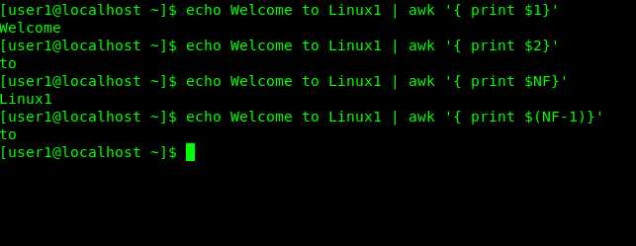
awk
The oddly-named awk command can extract a field (or multiple fields), by field number, from one or more input lines.
The default is to find fields separated by any number of space characters
Look for option –F in man page for awk command

Slide 43
COMMANDS
head -n (first n lines of the file)
tail -n (last n lines of the file)
echo (standard write command in the terminal)
wc -l (counts the number of lines in the output)
sort (sort list of input )
more (show output page by page)
grep (look for a pattern in input stream)
sed (Stream editor)
awk (used to extract a field (or multiple fields))
find

Slide 44
Questions ?

